Slide 1
Characterization of a Hypersonic Wind Tunnel Nozzle
Addison Plummer
Advisor: Dr. Jesse Little
Funded by ONR
University of Arizona, Aerospace and Mechanical Engineering
Notes:
Fix arrangement of everything. Gave you new master slide, check slide numbers

Slide 2
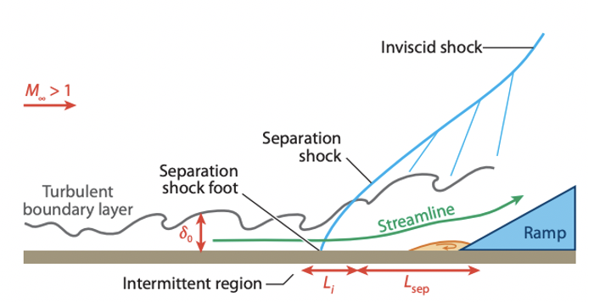
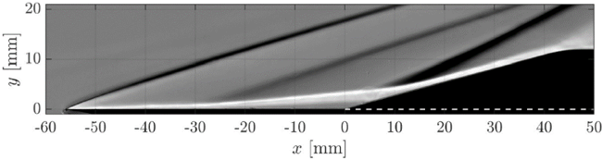
Introduction and Objective
Characterize a new Mach 5 nozzle
Once baseline flow is established, investigate transitional shock-boundary layer interaction (SBLI) physics
Why is this important?
Diagram of SBLI with turbulent BL and compression ramp [1]
Schlieren of SBLI with 15º compression ramp [2]
Notes:
Ask james for another picture from our abastract if time. Pretty sbli schlieren

Slide 3
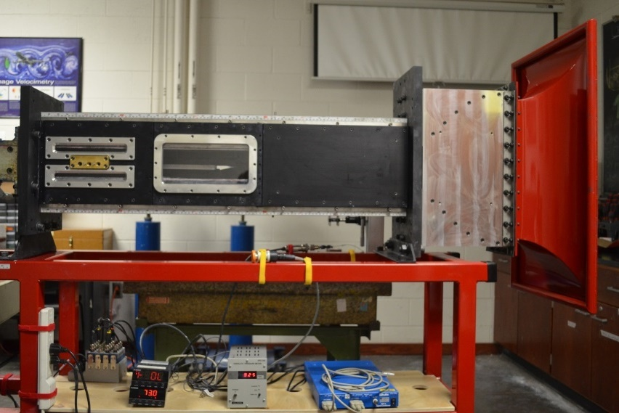
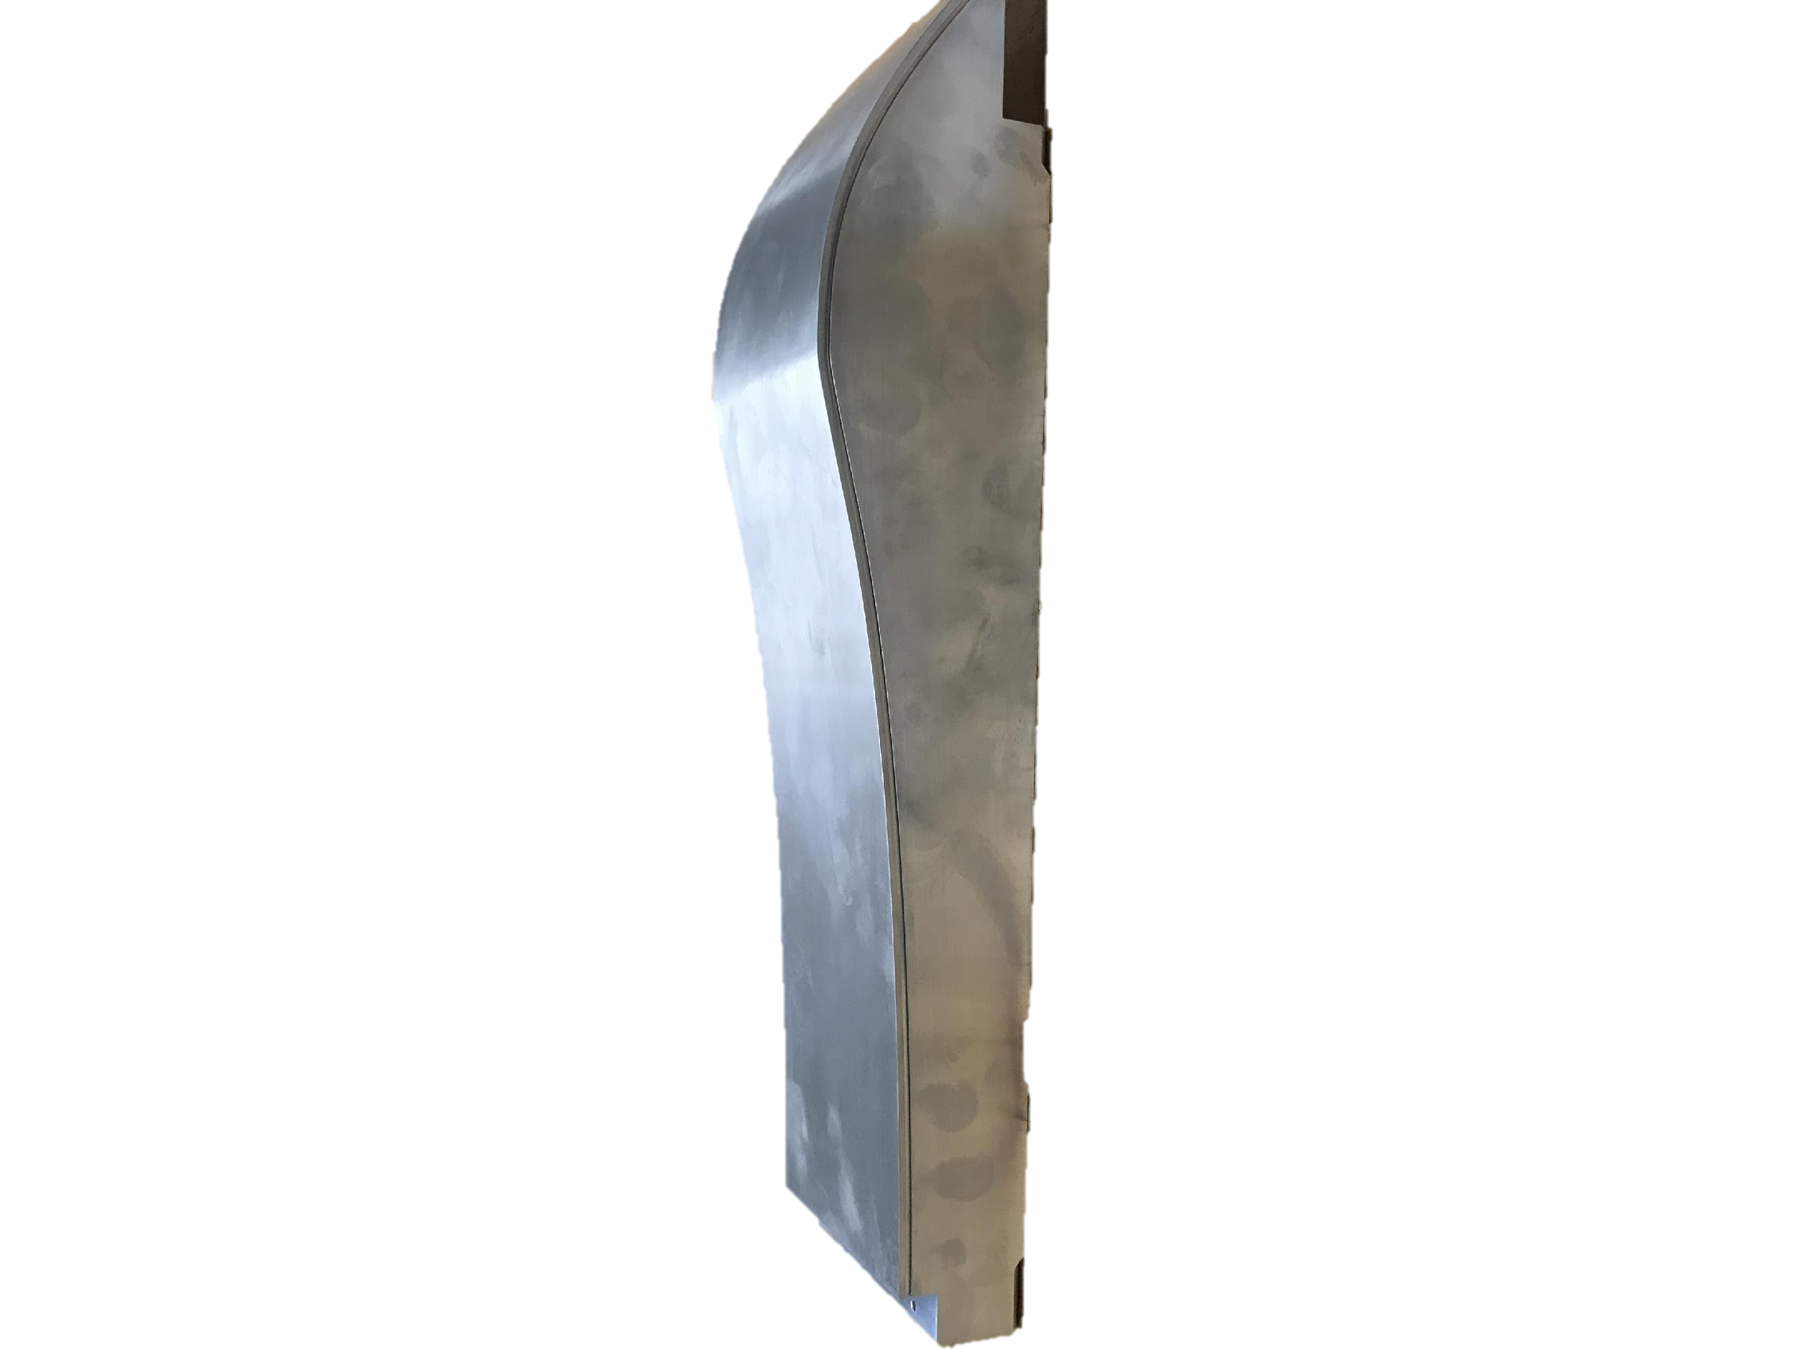
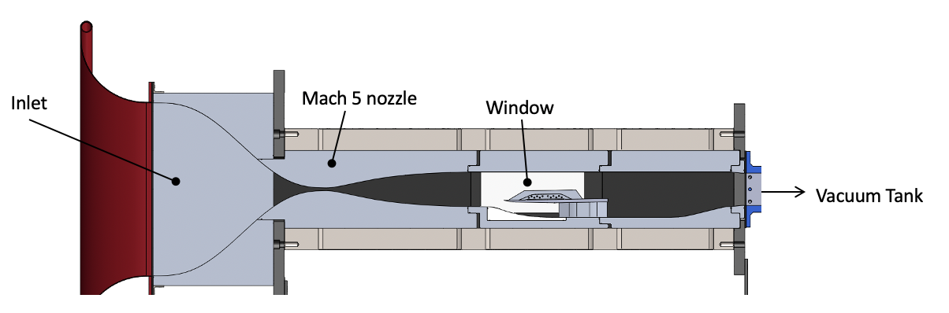
Facility
Located at the AME building at the University of Arizona
Supersonic in-draft (suction) wind tunnel
Working section: 122 x 81 x 610 mm (4.8” x 3.2” x 24”, W x H x L)
Exhaust to 34 m^3 (1200 ft³) vacuum chamber
Typical run times 10-15 s
Large windows for optical access
Flow direction
Model of the in-draft wind tunnel
One Mach 5 nozzle
Notes:
As james for picture of tunnel

Slide 4
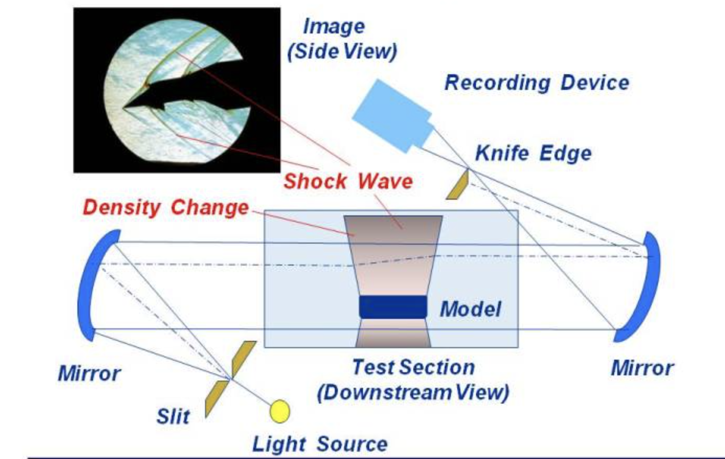
Data Acquisition Methods: Schlieren
Visual representation of the first derivative of density
Light rays enter parallel, then are refracted by density gradients
Bent rays blocked by knife edge
Can use a similarity solution for Mach 5 to compare to our laminar boundary layer (BL) in the schlieren
Schlieren example [3]
Notes:
Added laminar

Slide 5
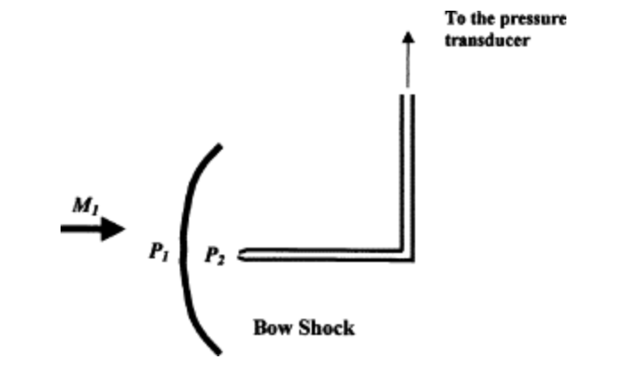
Data Acquisition Methods: Pitot Rake
The rake measures the difference in total pressure across the shock (p₀₂/p₀₁)
A sensor measures the pressure before the shock (room pressure, p₀₁)
We can use normal shock relations to find the Mach number
Rake pressure recorded with another sensor and LabView
Calculations performed with MATLAB
Pitot tube in supersonic flow example [4]
Notes:
Mensor is a brand name, I changed to sensor. Same with scanivalve

Slide 6
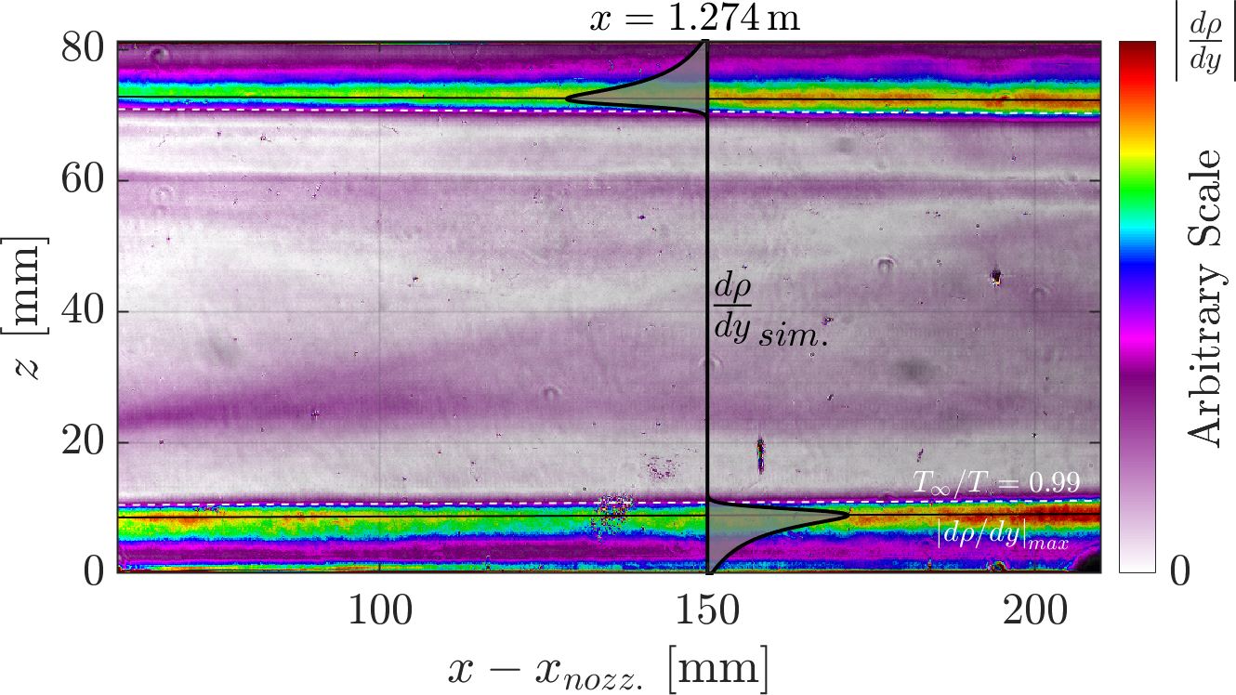

Schlieren
Average of images and background subtraction with MATLAB
Can use a similarity solution for Mach 5 to compare to our laminar boundary layer (BL) in the schlieren
BL thickness is approximately 8.8 mm
Max density gradient matches similarity solution
Flow direction
(Color scale altered to observe gradient more clearly) Schlieren of empty tunnel with overlapping similarity solution courtesy of James Threadgill
Notes:
These are pseudo colors, you should acknowledge James here.

Slide 7
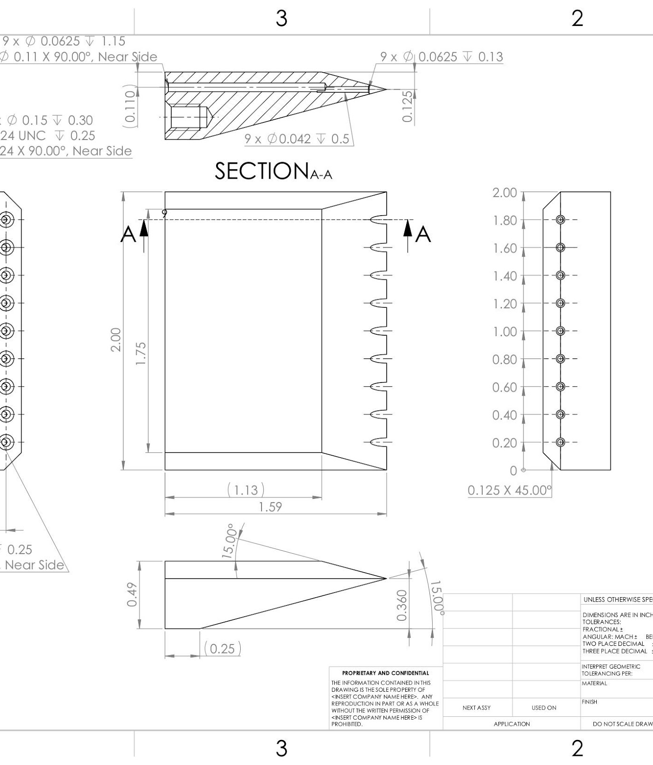
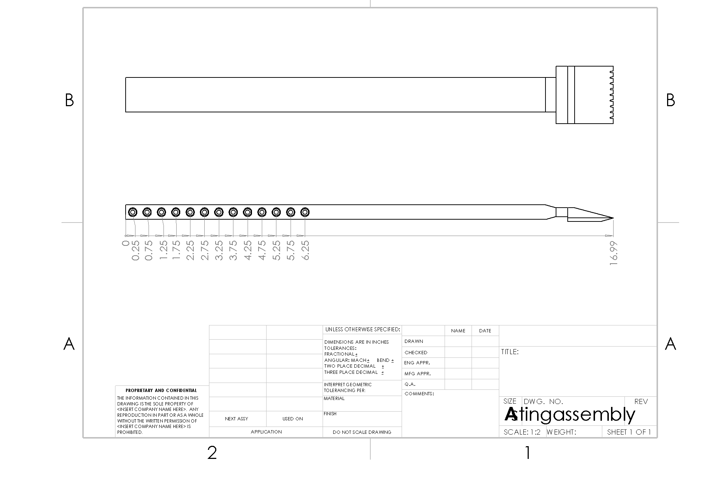
Design for Sting Mounted Rake
Positioned on a sting to take measurements away from the sidewall
Measures at different spanwise locations with 9 pitot tubes
Can be repositioned to measure at different heights and streamwise locations
Flow direction

Slide 8
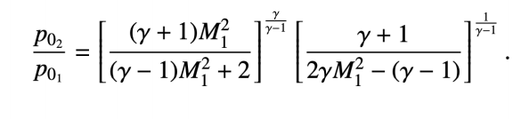
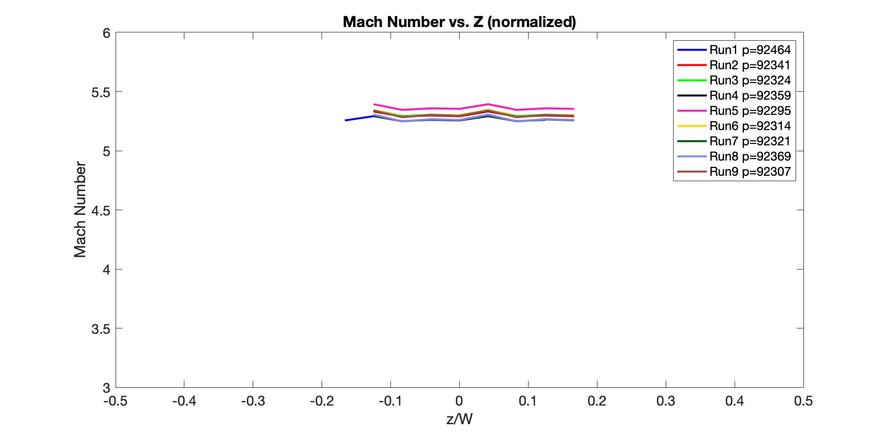
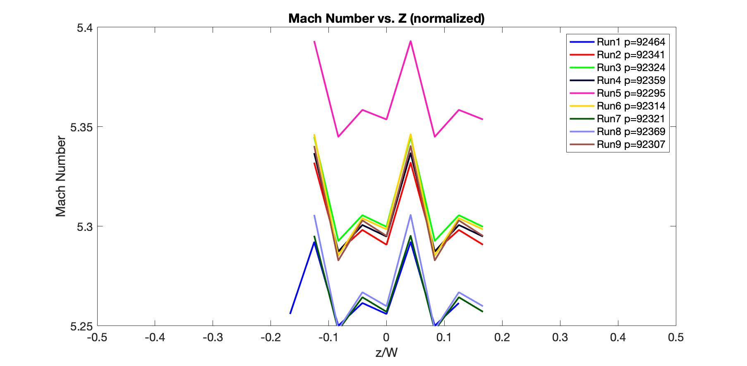
Mach Number Results
Slight discrepancies between runs may be due to slight change in room pressure, door open/closed, humidity, temperature, etc.
Graph showing the Mach number at each pitot tube location
Closer look of graph showing the Mach number at each pitot tube location
Notes:
I would zoom in. Text too small

Slide 9
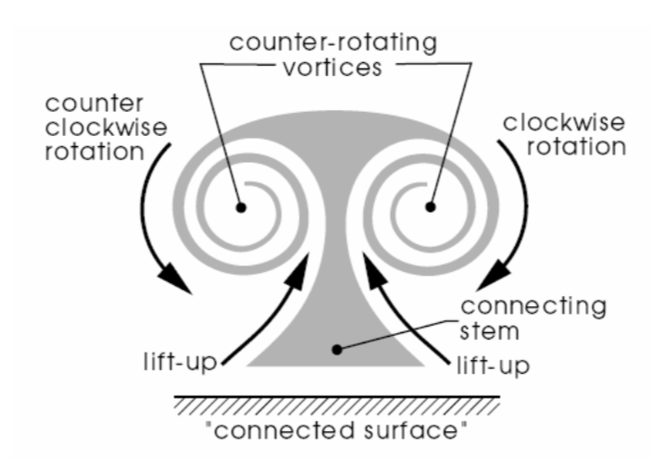
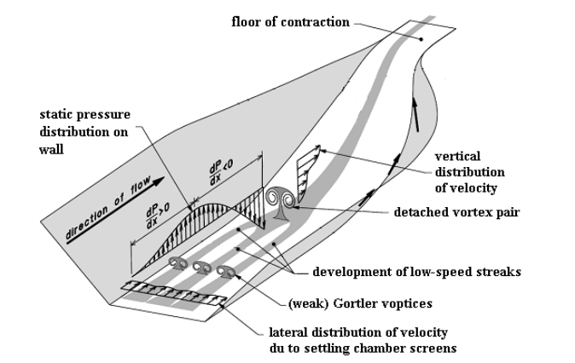
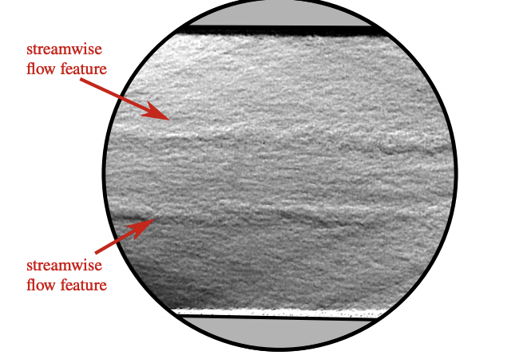
Checking for Vortical Structures
Disturbance identified on sidewall
Could be induced by nozzle geometry
Qualitative comparison between Schlieren, Mach numbers, and computational work is ongoing
Mach waves in schlieren indicating streamwise vortices on the side wall [5]
Diagram of vortex propagating downstream [6]
Notes:
Zoom in and make everything bigger. NO SQUINTING!!

Slide 10
Conclusions & Next Steps
Conclusions
  Installed Mach 5 nozzle
  Used schlieren imaging and comparison with theoretical BL to verify flow quality
  Experiments with pressure measurements using pitot rake to calculate Mach number
    Shows that it is actually Mach 5.3
  Examined additional disturbances on sidewall (ongoing)
Next Steps
  Finalize Mach number investigation
  Establish experimental techniques for creating controlled disturbances
    Control state of incoming boundary layer ahead of the SBLI using plasma actuators
Notes:
bigger

Slide 11


Acknowledgements & References
Thank you!
Arizona Space Grant
Office of Naval Research
Dr. Jesse Little
Dr. James Threadgill
John Flood
References:
[1] Clemens, N. T., & Narayanaswamy, V. (2014). Low-frequency unsteadiness of shock wave/turbulent boundary layer interactions. Annual Review of Fluid Mechanics, 46(1), 469-492. doi:10.1146/annurev-fluid-010313-141346
[2] Threadgill et al., 2019
[3] https://www.grc.nasa.gov/www/k-12/airplane/tunvschlrn.html
[4] Bruno Chanetz, Amer Chpoun, in Handbook of Shock Waves, 2001
[5] Sabnis, K., Babinsky, H., Galbraith, D. S., & Benek, J. A. (2021). Nozzle Geometry-Induced vortices in SUPERSONIC wind tunnels. AIAA Journal, 59(3), 1087-1098. doi:10.2514/1.j059708
[6] Dehghan Manshadi, Mojtaba & Mirzaei, Mohsen & Ghorbanian, K.. (2009). Control of pressure gradient in the contraction of a wind tunnel. 40. 261-266.

